Slide 1
Event Report Classification
Jesse Robles

Slide 2
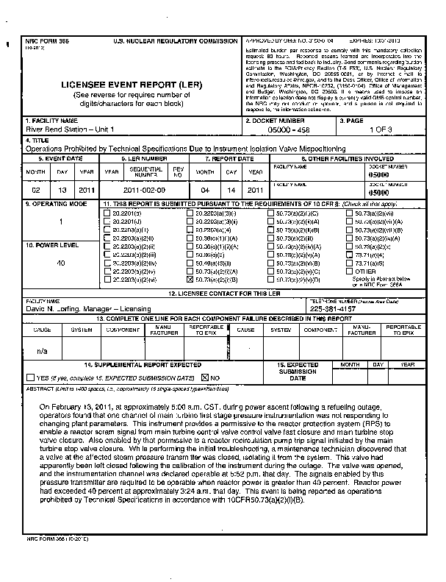
Background
Submitted event reports are manually classified into ~16 categories to send to reviewers
Objective is to build a model to classify documents into these categories to ensure they are reviewed by appropriate individuals
Obtaining the documents (pdfs) and extracting the text was the most time-consuming task

Slide 3
Models

Slide 4
Evaluation Metrics

Slide 5
Results

